Slide 1






Slide 2

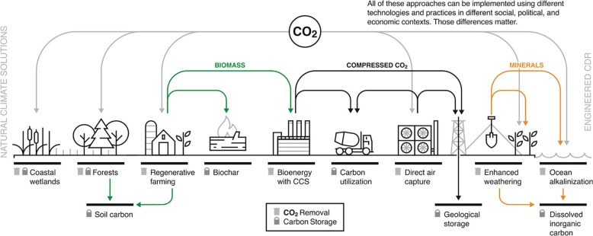
Low et al., 2020
Notes:
Introduce everyone and say a few words about the different partner’s expertise

Slide 3
Engineered carbon removal
Low et al., 2020
Notes:
Introduce everyone and say a few words about the different partner’s expertise

Slide 4
Engineered carbon removal
Geologically stored
carbon removal
Low et al., 2020
Notes:
Introduce everyone and say a few words about the different partner’s expertise

Slide 5
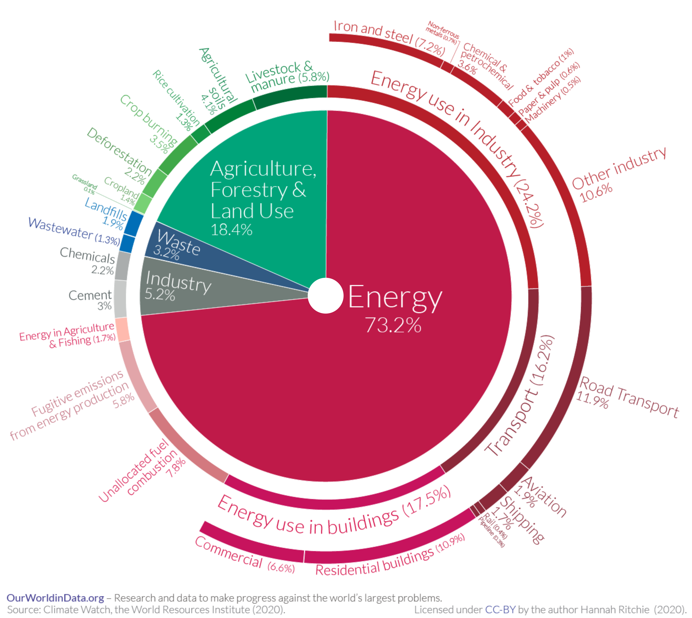
How much CO₂ do we need to remove?
Notes:
Introduce everyone and say a few words about the different partner’s expertise

Slide 6
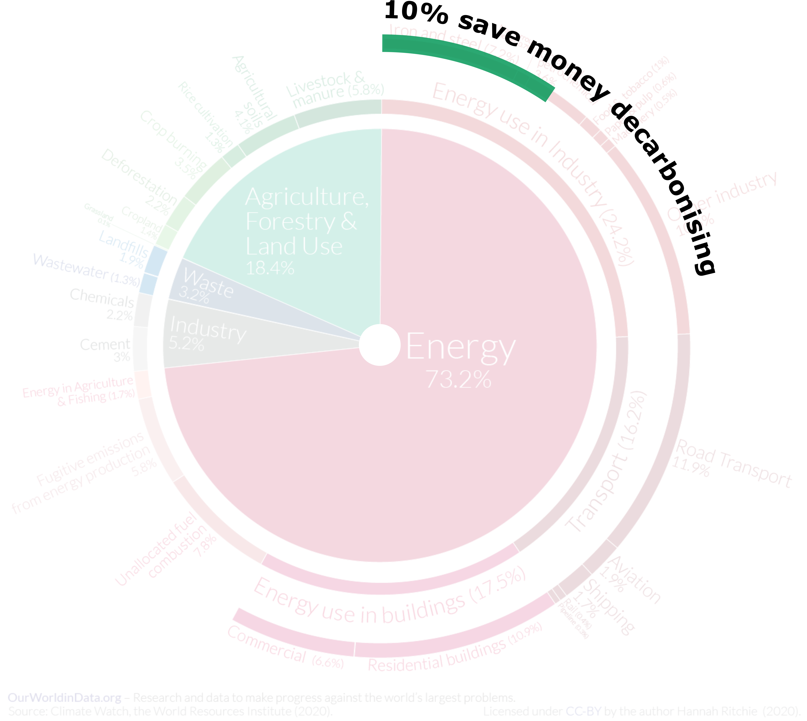
Notes:
Introduce everyone and say a few words about the different partner’s expertise

Slide 7
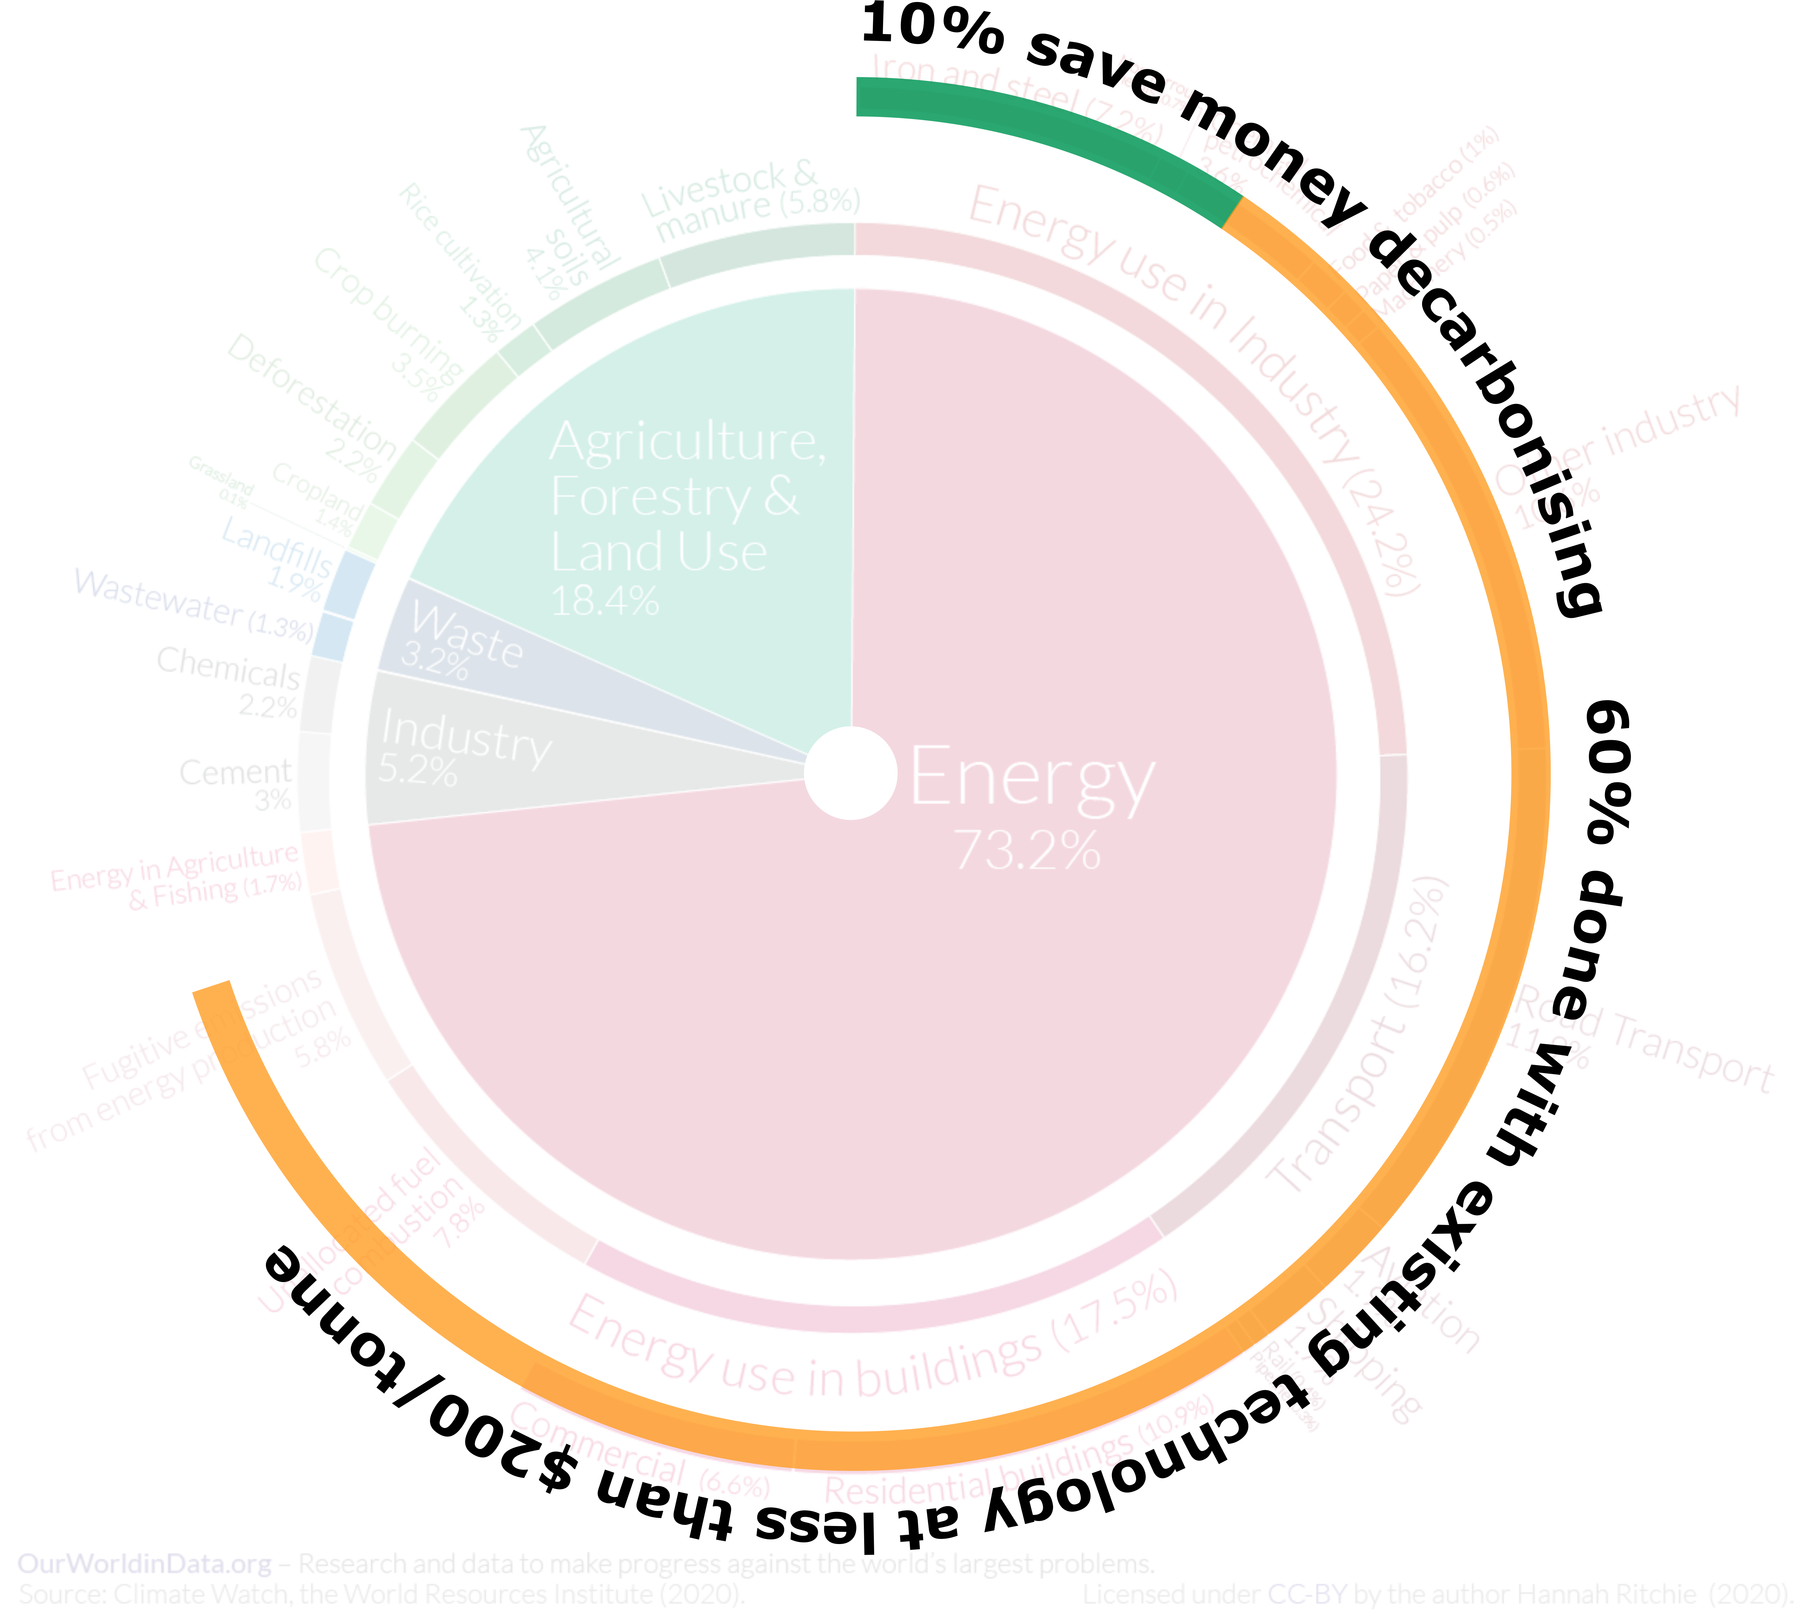
Notes:
Introduce everyone and say a few words about the different partner’s expertise

Slide 8
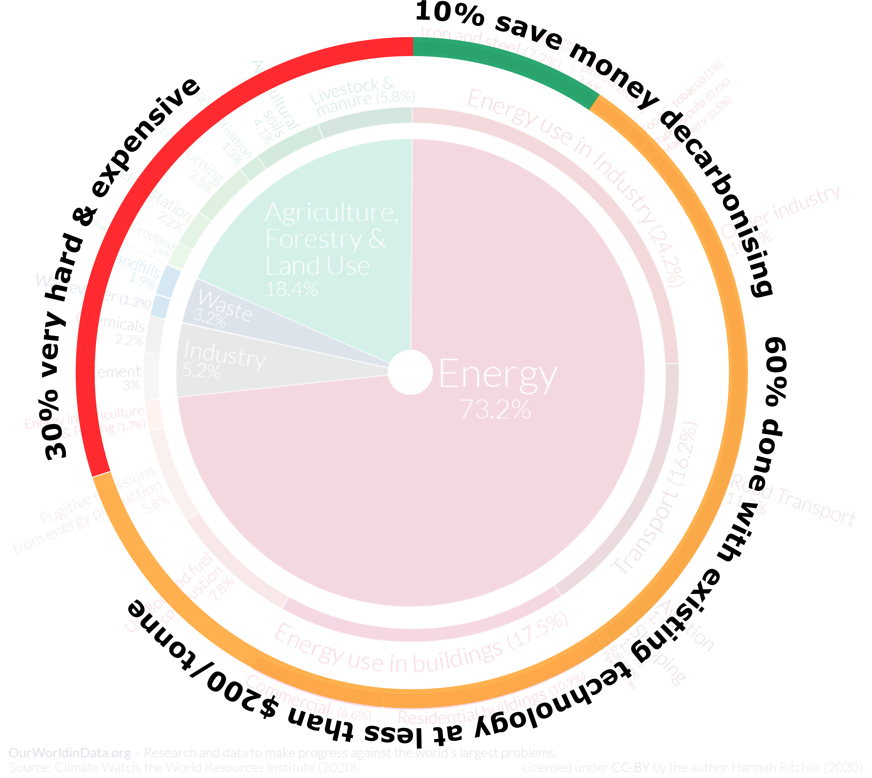
Notes:
Introduce everyone and say a few words about the different partner’s expertise

Slide 9
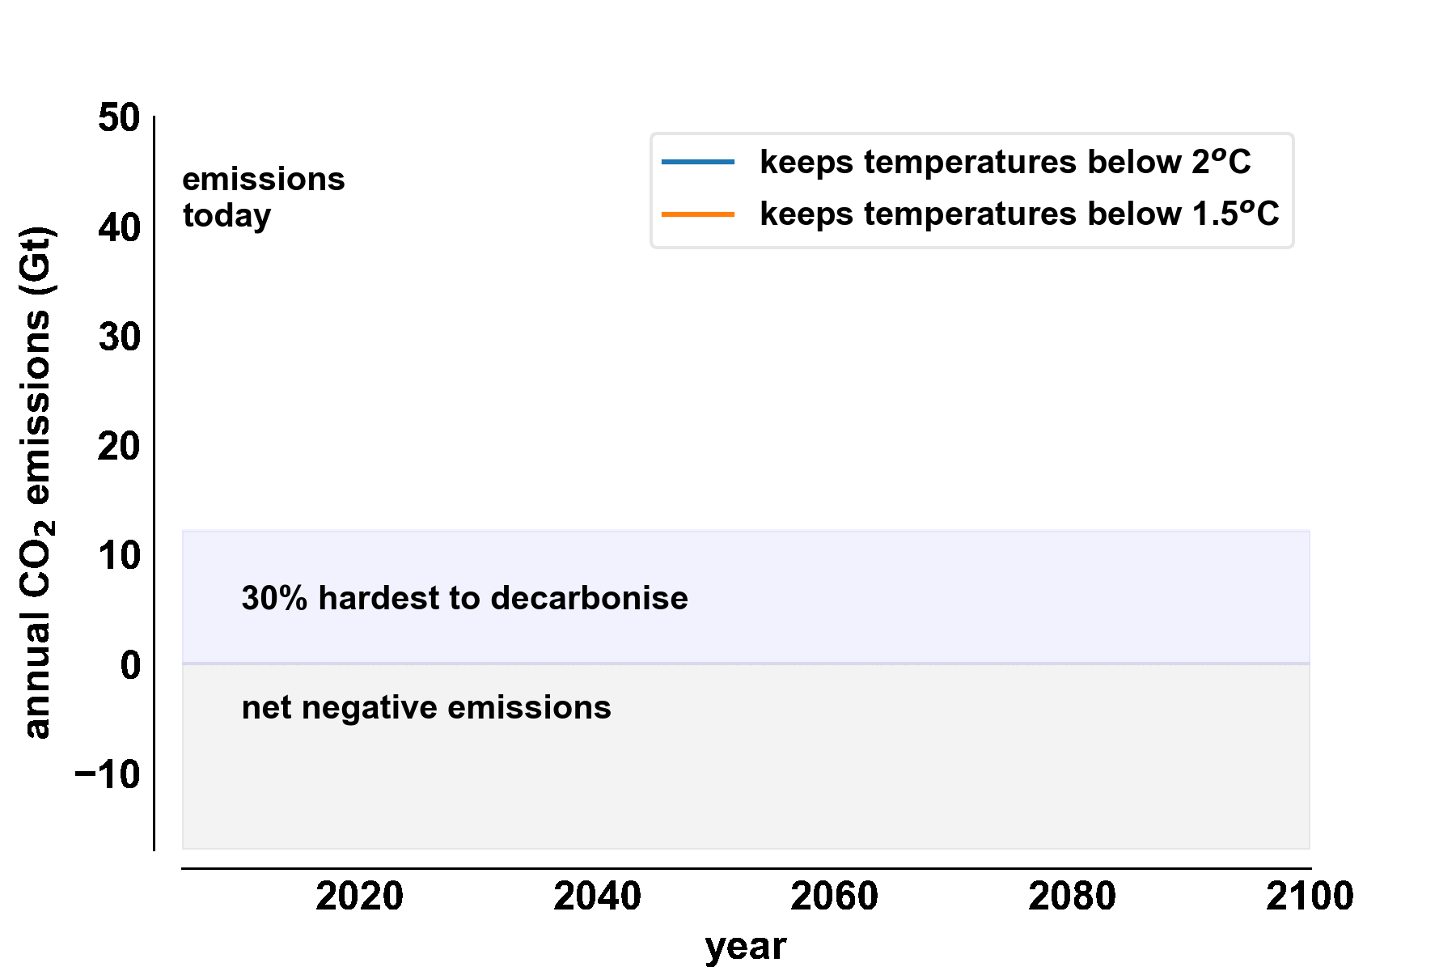
How much CO₂ do we need to remove?
Notes:
Introduce everyone and say a few words about the different partner’s expertise

Slide 10
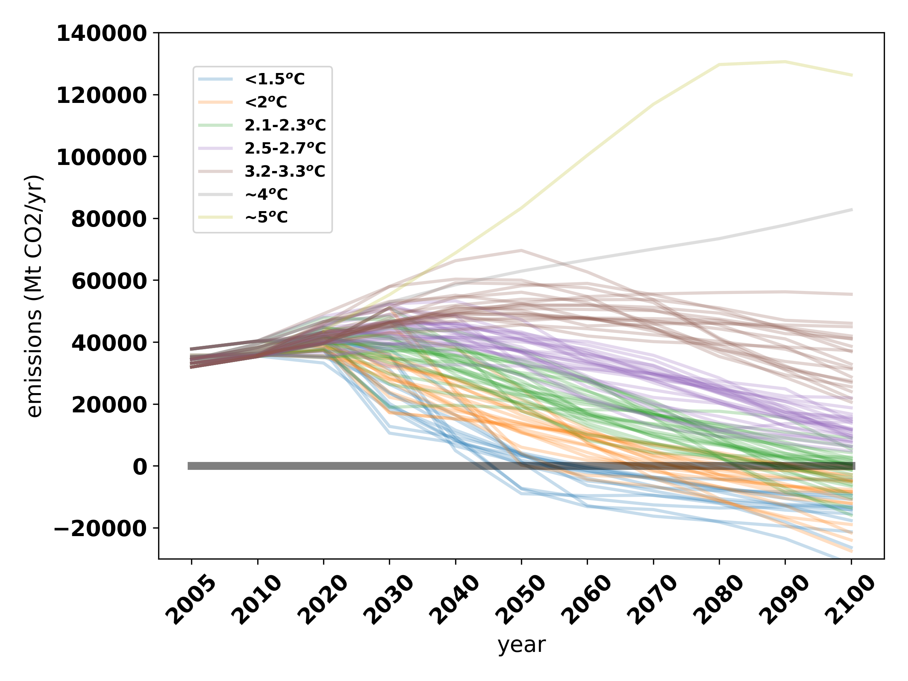
Scenarios without significant climate policy
Modest emissions reductions
Negative
emissions
Emissions targeted at <2 degrees

Slide 11
?
some offsetting aviation etc.
definite negative emissions

Slide 12
10000 Mt CO₂/year
?
some offsetting aviation etc.
definite negative emissions

Slide 13
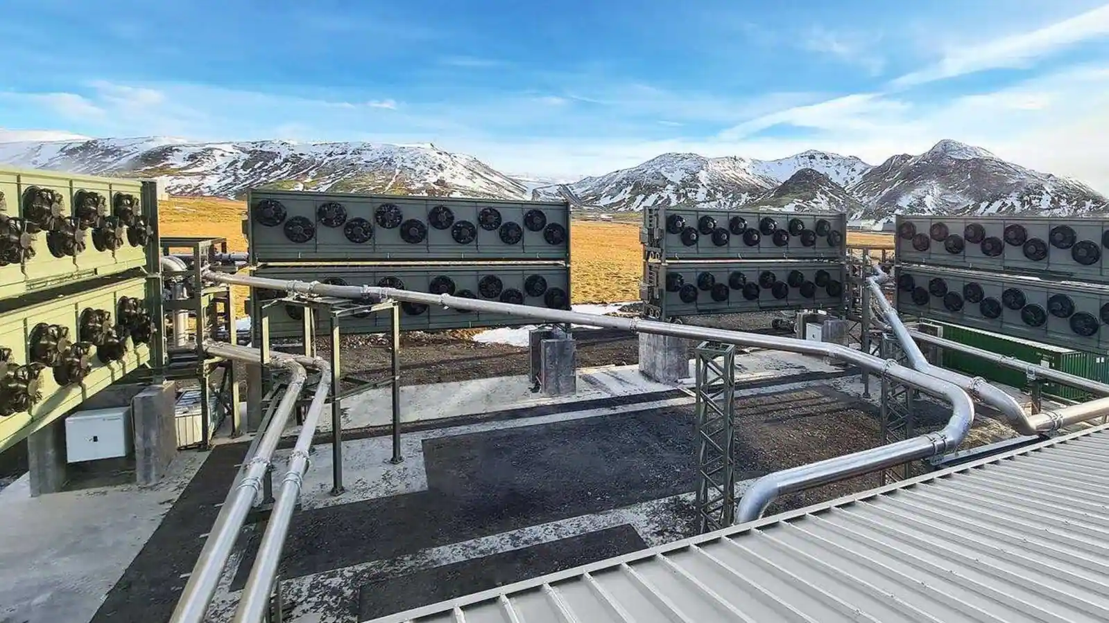
10000 Mt CO₂/year
?
some offsetting aviation etc.
definite negative emissions
Orca, Iceland: 4kt/yr
2.5 million plants like this.
Distributed equally over the land surface that is 4500 plants in the UK

Slide 14
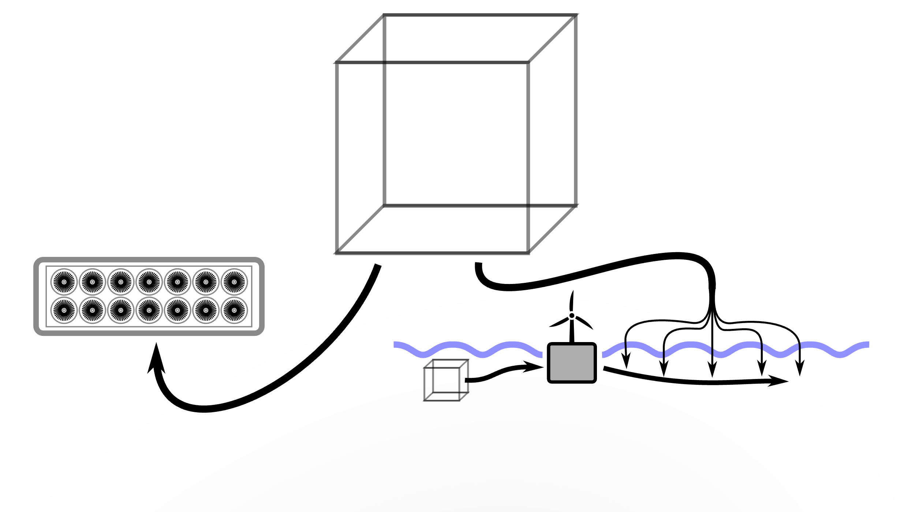
Why marine Negative Emissions Technologies?
Seawater CO₂ concentration approx. 150 times that in air
1 unit of CO₂
in air
DAC
SeaCURE
1 unit of CO₂
in seawater
Notes:
Briefly explain why we believe that marine mediated GGR offers significant benefits over direct air capture.

Slide 15
What is the likely scale of activity?
10000 Mt CO₂/year
?
some offsetting aviation etc.
definite negative emissions
Orca, Iceland: 4kt/yr
2500 thousand plants like this.
Distributed equally over the land surface that is 4500 plants in the UK
1% of the ocean surface water through our approach every year.

Slide 16
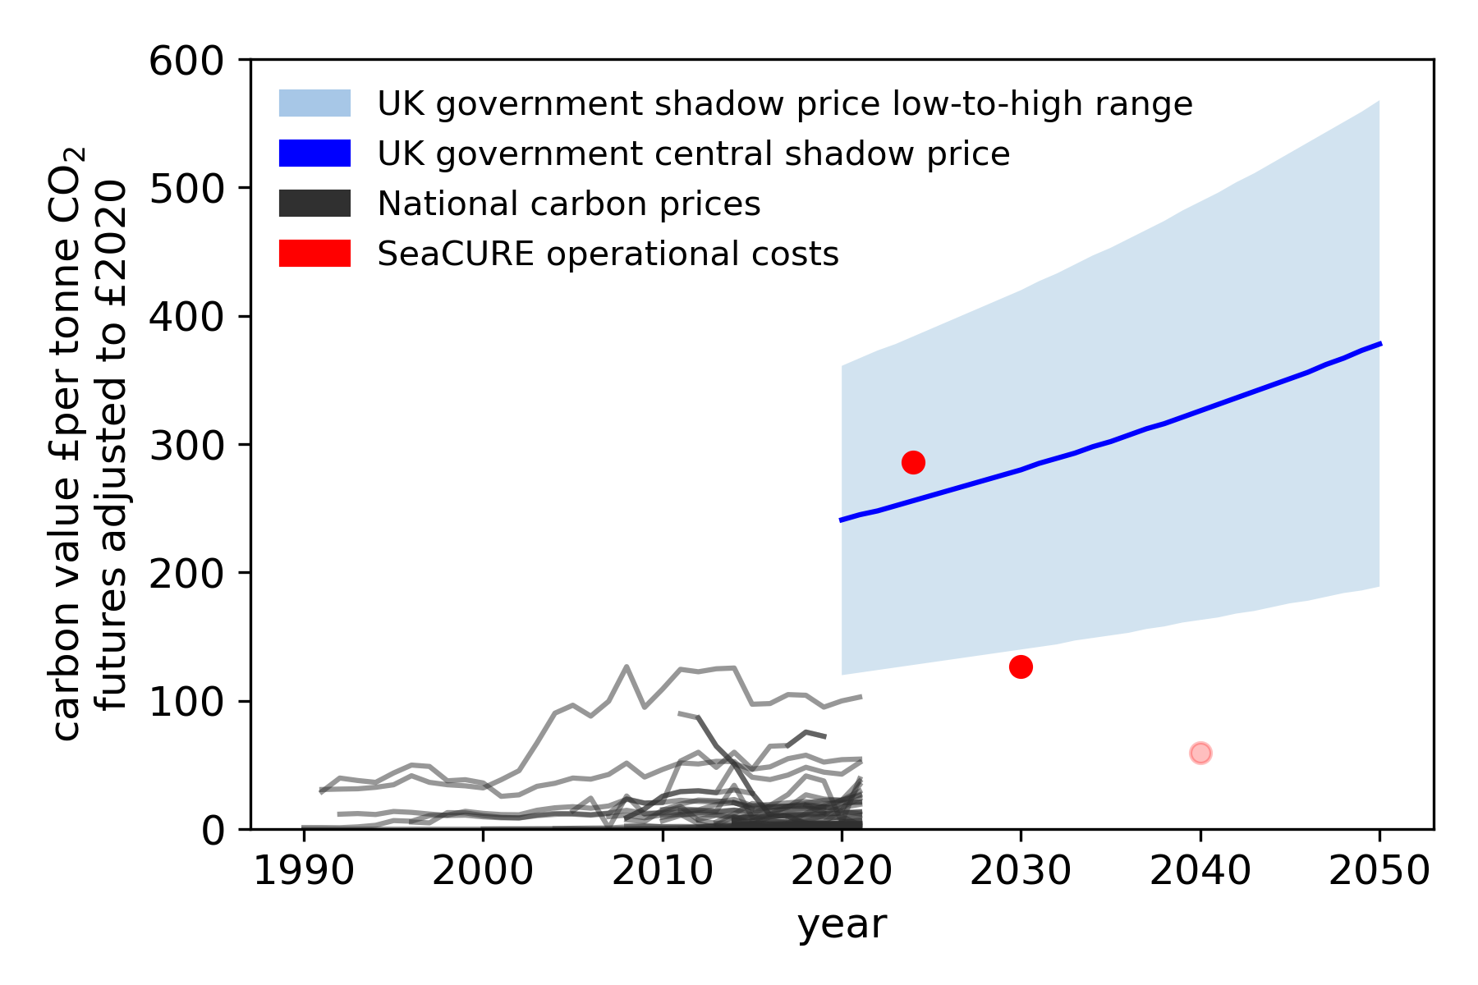
Pilot plant
2030 plant
Potential future plant
Shadow price = price to use when considering GHG impact of policy proposals
Notes:
The government uses these values to estimate a monetary value of the greenhouse gas impact of policy proposals during policy design, and also after delivery. Note - they differ from carbon prices, which represent the observed price of carbon in a relevant market (such as the UK Emissions Trading Scheme)
http://localhost:8888/lab/tree/carbon_pricing.ipynb
https://www.gov.uk/government/publications/valuing-greenhouse-gas-emissions-in-policy-appraisal/valuation-of-greenhouse-gas-emissions-for-policy-appraisal-and-evaluation

